Slide 1

Contrasts & Statistical Inference
Christophe Phillips
SPM Course

Slide 2
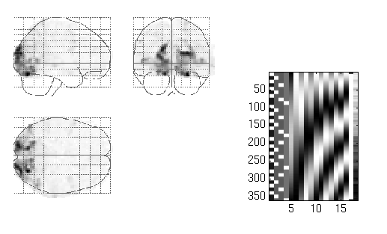
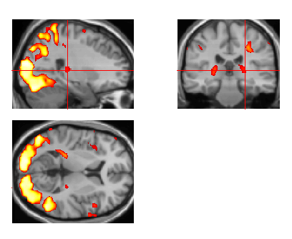
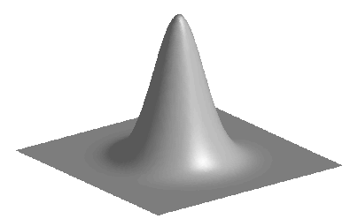
Image time-series
Spatial filter
Design matrix
Statistical Parametric Map
Realignment
Smoothing
General Linear Model
Statistical Inference
RFT
Normalisation
Anatomical reference
p <0.05
Parameter estimates

Slide 3
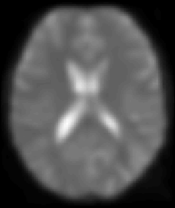
A mass-univariate approach
Time

Slide 4
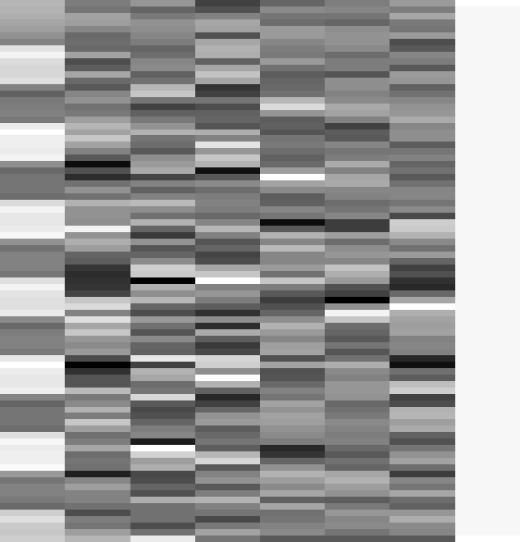


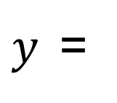

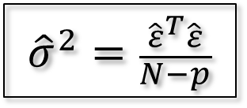
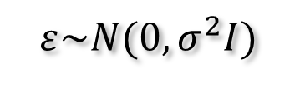
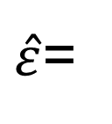



Estimation of the parameters
i.i.d. assumptions:
$$ε\sim N(0,σ^{2}I)$$
OLS estimates:
$$\hat{β}={(X^{T}X)}^{−1}X^{T}y$$
$${\hat{β}}_{1}=3.9831$$
$${\hat{β}}_{2−7}=\{0.6871, 1.9598, 1.3902, 166.1007, 76.4770, −64.8189\}$$
$$β$$
$${\hat{β}}_{8}=131.0040$$
$y$=
$$+ε$$
$\hat{ε}$=
$${\hat{σ}}^{2}=\frac{{\hat{ε}}^{T}\hat{ε}}{N−p}$$
$$\hat{β}\sim N\left(β,σ^{2}{(X^{T}X)}^{−1}\right)$$

Slide 5
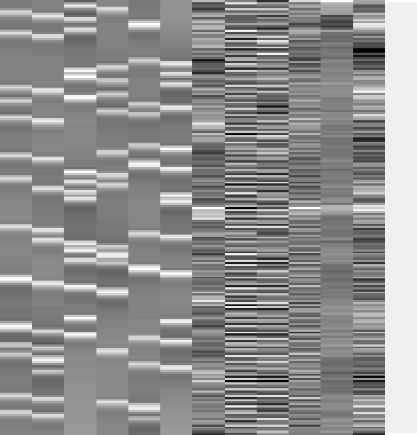
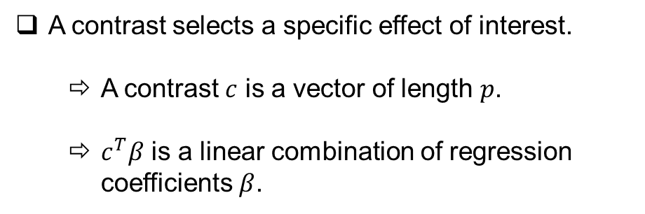

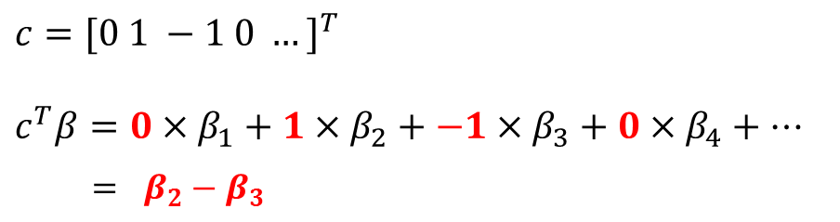
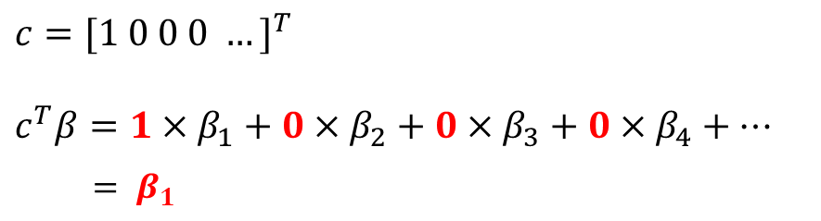
Contrasts
A contrast selects a specific effect of interest.
A contrast $c$ is a vector of length $p$.
$c^{T}β$ is a linear combination of regression coefficients $β$.
[1 0 0 0 0 0 0 0 0 0 0 0 0 0]
[0 1 -1 0 0 0 0 0 0 0 0 0 0 0]
$$c={[1 0 0 0 …]}^{T}$$
$$c^{T}β=1×β_{1}+0×β_{2}+0×β_{3}+0×β_{4}+…$$
$= β_{1}$
$$c={[0 1 −1 0 …]}^{T}$$
$$c^{T}β=0×β_{1}+1×β_{2}+−1×β_{3}+0×β_{4}+…$$
$$= β_{2}−β_{3}$$
$$c^{T}\hat{β}\sim N\left(c^{T}β,σ^{2}c^{T}{(X^{T}X)}^{−1}c\right)$$

Slide 6
Hypothesis Testing
To test a hypothesis, we construct “test statistics”.
Null Hypothesis H₀
Typically what we want to disprove (no effect).
⇨ The Alternative Hypothesis H_{A} expresses outcome of interest.
Test Statistic T
The test statistic summarises evidence about H₀.
Typically, test statistic is small in magnitude when the hypothesis H₀ is true and large when false.
⇨ We need to know the distribution of T under the null hypothesis.
Null Distribution of T

Slide 7
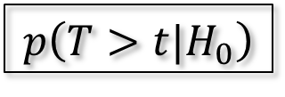
Hypothesis Testing
Significance level α:
Acceptable false positive rate α.
⇨ threshold u_{α}
Threshold u_{α} controls the false positive rate
u_{α}
α
Null Distribution of T
Conclusion about the hypothesis:
We reject the null hypothesis in favour of the alternative hypothesis if t > u_{α}
t
p-value:
A p-value summarises evidence against H₀.
This is the chance of observing value more extreme than t under the null hypothesis.
p-value
$$p\left(T>t|H_{0}\right)$$
Null Distribution of T

Slide 8
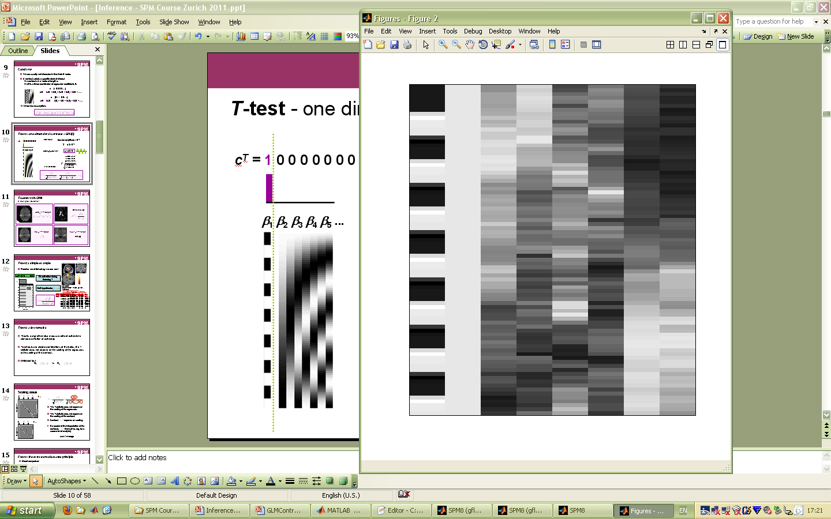
T-test - one dimensional contrasts – SPM{t}
Question:
box-car amplitude > 0 ?
=
β₁ = c^{T}β> 0 ?
c^{T} = 1 0 0 0 0 0 0 0
β₁ β₂ β₃ β₄ β₅ ...
Null hypothesis:
H₀: c^{T}β=0
contrast of estimated parameters
Test statistic:
T =
variance estimate

Slide 9
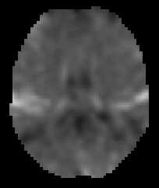
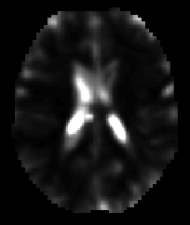
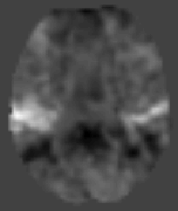
T-contrast in SPM
For a given contrast c:
ResMS image
beta_???? images
con_???? image
spmT_???? image
SPM{t}

Slide 10
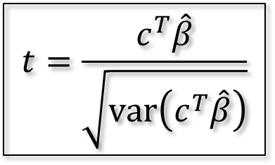
T-test: a simple example
Passive word listening versus rest
c^{T} = [ 1 0 0 0 0 0 0 0]
Q: activation during listening ?
1
Null hypothesis:
SPMresults:
Height threshold T = 3.2057 {p<0.001}
voxel-level
mm mm mm
T
(
Z
≡
)
p
uncorrected
13.94
Inf
0.000
-63 -27 15
$$t=\frac{c^{T}\hat{β}}{\sqrt{\text{var}\left(c^{T}\hat{β}\right)}}$$
12.04
Inf
0.000
-48 -33 12
11.82
Inf
0.000
-66 -21 6
13.72
Inf
0.000
57 -21 12
12.29
Inf
0.000
63 -12 -3
9.89
7.83
0.000
57 -39 6
7.39
6.36
0.000
36 -30 -15
6.84
5.99
0.000
51 0 48
6.36
5.65
0.000
-63 -54 -3
6.19
5.53
0.000
-30 -33 -18
5.96
5.36
0.000
36 -27 9
5.84
5.27
0.000
-45 42 9
5.44
4.97
0.000
48 27 24
5.32
4.87
0.000
36 -27 42

Slide 11
T-test: summary
T-test is a signal-to-noise measure (ratio of estimate to standard deviation of estimate).
Alternative hypothesis:
H₀:
vs H_{A}:
T-contrasts are simple combinations of the betas; the T-statistic does not depend on the scaling of the regressors or the scaling of the contrast.

Slide 12
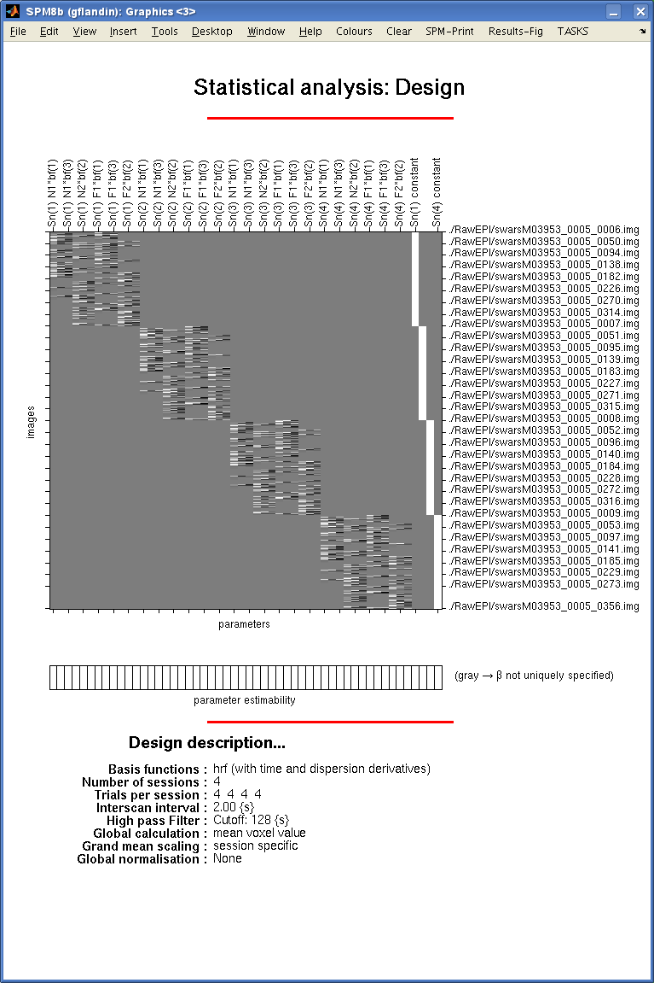
Scaling issue
[1 1 1 1 ]
/ 4
Subject 1
The T-statistic does not depend on the scaling of the regressors.
The T-statistic does not depend on the scaling of the contrast.
Contrast depends on scaling.
[1 1 1 ]
/ 3
Be careful of the interpretation of the contrasts themselves (eg, for a second level analysis): sum ≠ average
Subject 5

Slide 13
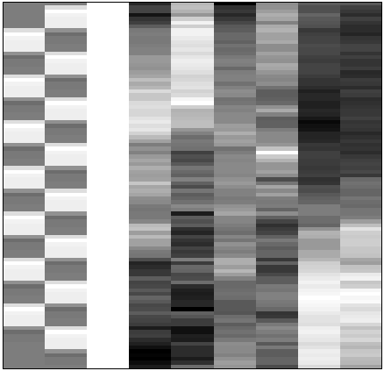
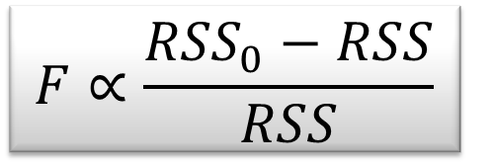
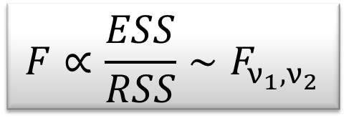
F-test - the extra-sum-of-squares principle
Model comparison:
Null Hypothesis H₀: True model is X₀ (reduced model)
X₀
X₁
X₀
Test statistic: ratio of explained variability and unexplained variability (error)
RSS
RSS₀
ν₁ = rank(X) – rank(X₀)
ν₂ = N – rank(X)
Full model ?
or Reduced model?

Slide 14
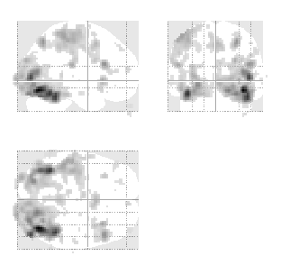
F-test - multidimensional contrasts – SPM{F}
Tests multiple linear hypotheses:
H₀: True model is X₀
H₀: β₄ = β₅ = ... = β₉ = 0
test H₀ : c^{T}β = 0 ?
X₀
X₁ (β₄₋₉)
X₀
0 0 0 1 0 0 0 0 0
0 0 0 0 1 0 0 0 0
0 0 0 0 0 1 0 0 0
0 0 0 0 0 0 1 0 0
0 0 0 0 0 0 0 1 0
0 0 0 0 0 0 0 0 1
c^{T} =
SPM{F_{6,322}}
Full model?
Reduced model?

Slide 15
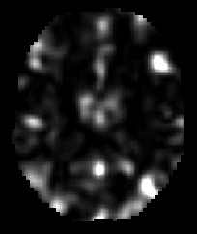
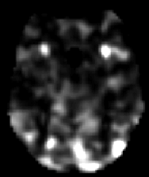
F-contrast in SPM
ResMS image
beta_???? images
ess_???? images
spmF_???? images
( RSS₀ - RSS )
SPM{F}

Slide 16
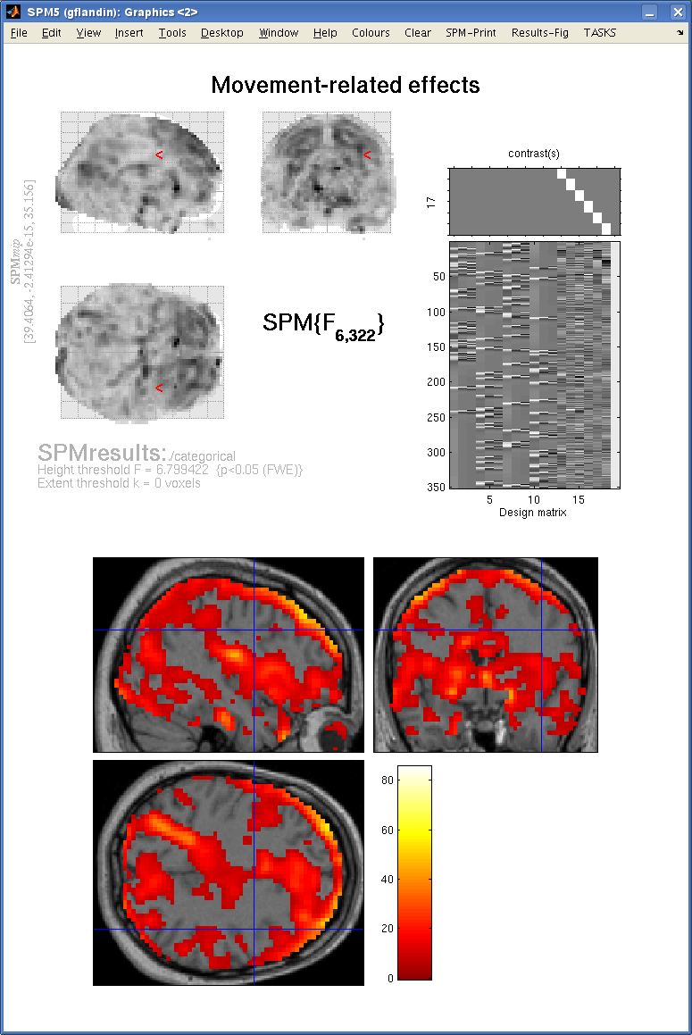

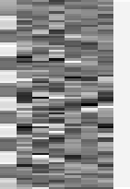
F-test example: movement related effects
contrast(s)
contrast(s)
10
20
30
40
50
10
60
70
20
80
2
4
6
8
Design matrix
30
40
50
60
70
80
2
4
6
8
Design matrix

Slide 17
F-test: summary
F-tests can be viewed as testing for the additional variance explained by a larger model w.r.t. a simpler (nested) model ⇨ model comparison.
F tests a weighted sum of squares of one or several combinations of the regression coefficients β.
In practice, we don’t have to explicitly separate X into [X₁X₂] thanks to multidimensional contrasts.
Hypotheses:
In testing uni-dimensional contrast with an F-test, for example β₁ – β₂, the result will be the same as testing β₂ – β₁. It will be exactly the square of the t-test, testing for both positive and negative effects.

Slide 18


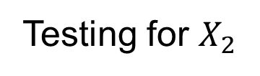
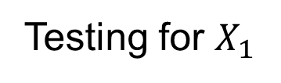
Orthogonal regressors
Variability described by $X_{1}$
Variability described by $X_{2}$
Testing for $X_{1}$
Testing for $X_{2}$
Variability in Y

Slide 19


Correlated regressors
Shared variance
Variability described by $X_{1}$
Variability described by $X_{2}$
Variability in Y

Slide 20


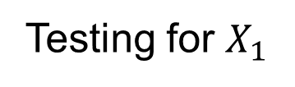
Correlated regressors
Testing for $X_{1}$
Variability described by $X_{1}$
Variability described by $X_{2}$
Variability in Y

Slide 21
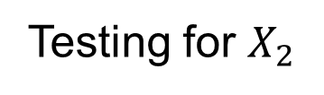
Correlated regressors
Testing for $X_{2}$
Variability described by $X_{1}$
Variability described by $X_{2}$
Variability in Y

Slide 22
Correlated regressors
Variability described by $X_{1}$
Variability described by $X_{2}$
Variability in Y

Slide 23


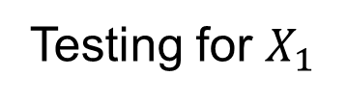
Correlated regressors
Testing for $X_{1}$
Variability described by $X_{1}$
Variability described by $X_{2}$
Variability in Y

Slide 24
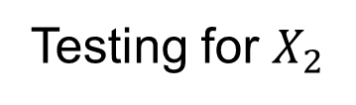
Correlated regressors
Testing for $X_{2}$
Variability described by $X_{1}$
Variability described by $X_{2}$
Variability in Y

Slide 25
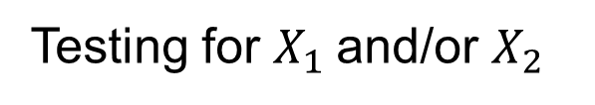
Correlated regressors
Testing for $X_{1}$and/or $X_{2}$
Variability described by $X_{1}$
Variability described by $X_{2}$
Variability in Y

Slide 26
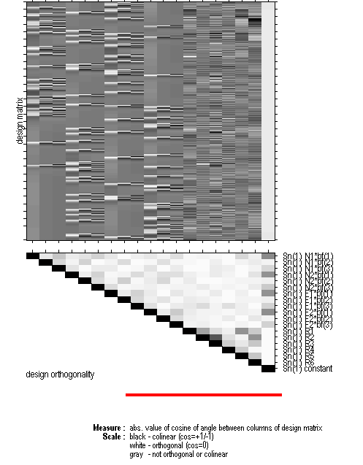
Design orthogonality
For each pair of columns of the design matrix, the orthogonality matrix depicts the magnitude of the cosine of the angle between them, with the range 0 to 1 mapped from white to black.
If both vectors have zero mean then the cosine of the angle between the vectors is the same as the correlation between the two variates.

Slide 27
Correlated regressors: summary
We implicitly test for an additional effect only. When testing for the first regressor, we are effectively removing the part of the signal that can be accounted for by the second regressor: ⇨ implicit orthogonalisation.
Orthogonalisation = decorrelation. Parameters and test on the non modified regressor change. Rarely solves the problem as it requires assumptions about which regressor to uniquely attribute the common variance. ⇨ change regressors (i.e. design) instead, e.g. factorial designs. ⇨ use F-tests to assess overall significance.
Original regressors may not matter: it’s the contrast you are testing which should be as decorrelated as possible from the rest of the design matrix
x₂
x₂
x⊥
x₂
₂
x⊥ = x₂ – x₁.x₂ x₁
x₁
₂
x₁
x₁
x⊥
₁

Slide 28
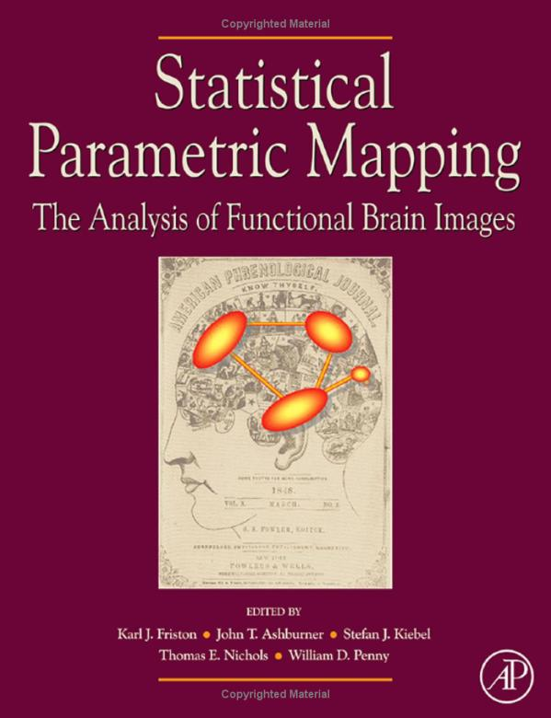
Bibliography:
Statistical Parametric Mapping: The Analysis of Functional Brain Images. Elsevier, 2007.
Plane Answers to Complex Questions: The Theory of Linear Models. R. Christensen, Springer, 1996.
Statistical parametric maps in functional imaging: a general linear approach. K.J. Friston et al, Human Brain Mapping, 1995.
Ambiguous results in functional neuroimaging data analysis due to covariate correlation. A. Andrade et al., NeuroImage, 1999.
Estimating efficiency a priori: a comparison of blocked and randomized designs. A. Mechelli et al., NeuroImage, 2003.

